Slide 1

It’s high time to change

Slide 2


Slide 3
In this period…
REINVENT

Slide 4
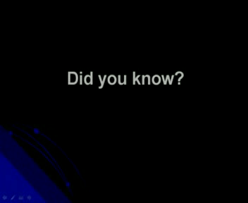

Slide 5
Everything has changed and keep on changing
Your job …. Is changing…
The way of making business is changing.
Everything is faster and faster…

Slide 6
The rules
The secret for success

Slide 7
1 )
Be an inclusive indivudual
Everybody in your group must be treated as your best friend or as your best Customer…. This is the only way you can receive an help to achieve your goal…
You cannot achieve any goal in your life by yourself…alone !!!

Slide 8
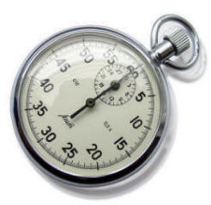
2
Don’t waste your time
1: 10.000 Of a second

Slide 9


Slide 10
If we scaled the age of the Universe (13billion years) into a single 24hour day, the average human lifespace would last 1/10,000 of a second. What will you do with your 1/10,000 of a second?

Slide 11
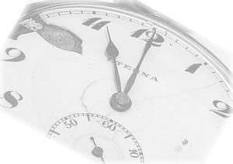
Personally
I don’t want to spend all my entire life in glorifyng the others
I don’t want to spend too much time to have aboundance of customers
I have no time for my co-workers/ collegues who are too pessimistic or too critic…
I have no time to listen those who scream… “the CRISIS”…. Because now the Market is a real opportunity

Slide 12


Slide 13
I have not enough time to became rich…..
I have not enough time to reach my goal
I have no time to create a family.

Slide 14

Question ?
Have you got an aim ?

Slide 15
A CLEAR AND BRIGHT AIM ?

Slide 16
So…how would you spend your time ?
How could you be faster and faster ?

Slide 17
To live an huge life
You must be EAGER
Of everything you consider
important

Slide 18
We waste time
Because we have
“against pourposes”

Slide 19
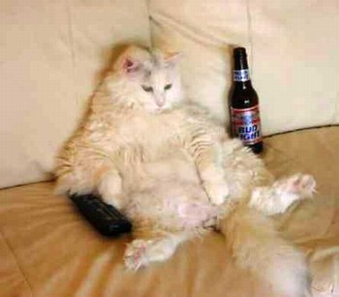
3
DON’T BE STUPID

Slide 20

Stupidity
The most dangerous power of the universe

Slide 21
You can’t weed it out
You can only recognize it

Slide 22
Advantage for others
Naive
Intelligent
Damage for yourself
Advantage for your own
Stupid
Gun man
Damage for the others

Slide 23
A stupid person is that one who cause a damage to another person or a group without having any adavantage for himself or even standing a loss
Carlo Cipolla : Economist

Slide 24
STUPIDITY STANDS FOR:
Do Not consider the TIME

Slide 25
4
YOU MUST LOVE YOUR JOB

Slide 26
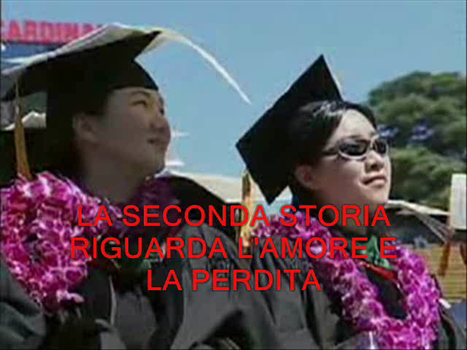

Slide 27
The love for your job Takes you High
Lets you approach to people “high tone”

Slide 28
5
Hard work

Slide 29
6
Be honest with people

Slide 30
7
have a good discipline

Slide 31
8
Have a partner that
Supports you

Slide 32
9
FIRE
1, 2, 3

Slide 33
Remember
Don’t waste time
It’s high time to make the
DIFFERENCE

